Slide 1


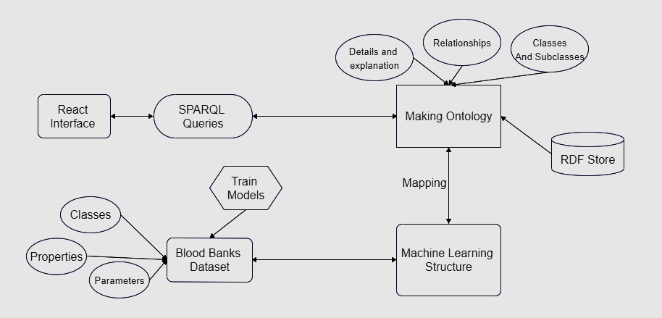








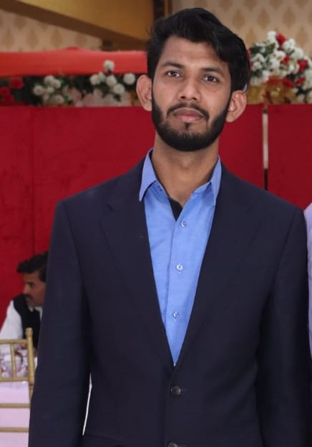
ML Onto Solution
For Blood Donation System
Final Year Project (2022-2023)
DEPARTMENT OF COMPUTER SCIENCE
INTRODUCTION
OBJECTIVES & SCOPE
Tools and Technologies
Group Members
FA19-BSE-112
AKASH UR REHMAN
FA19-BSE-033
AKASH UR REHMAN
FA19-BSE-098
AKASH UR REHMAN
SUPERVISOR:
Ms. SANA RIZWAN

